Slide 1
Code User Story Roel

Slide 2
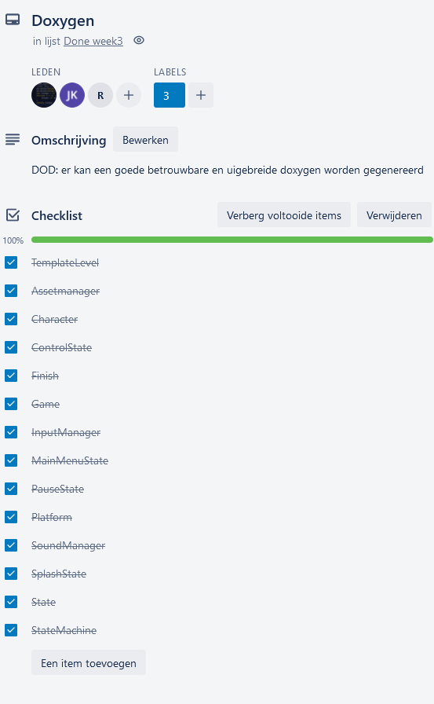
doxygen

Slide 3
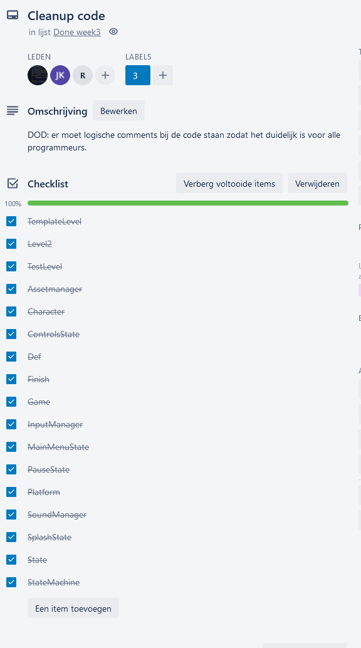
Main menu

Slide 4
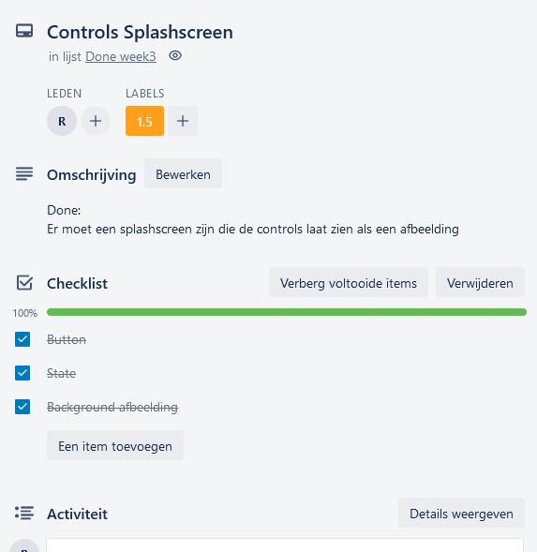
Splashcreen controls

Slide 5
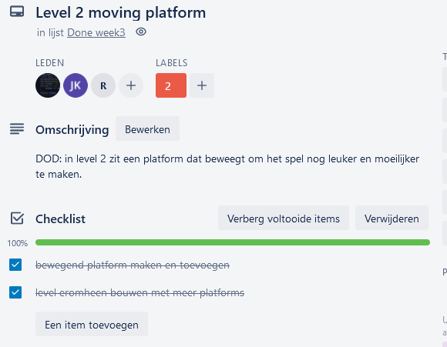
Moving platform

Slide 6
Code

Slide 7
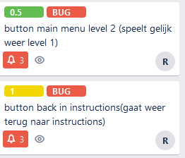
Extra taken

